Slide 1
An example-based introduction to spatial data mining with Python
Dr. Peter Mooney
peter.mooney@nuim.ie
https://github.com/petermooney/datamining

Slide 2

Who’s giving these lectures?
http://www.peterm7.com/mobile/me/

Slide 3
Preliminaries

Slide 4
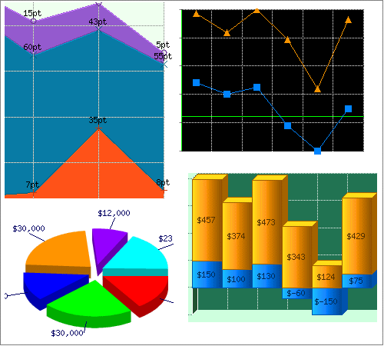
Data mining - very simplified view
DATA (Databases, Files, etc)
Querying
Data Extraction
Data Transformation
Data Analysis
Outputs - often best expressed as graphics and visualisations

Slide 5
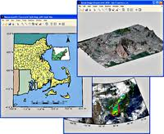
Spatial Data mining
- very simplified view (not very different really)
Spatial DATA (Databases, Files, etc)
Querying
Data Extraction
Data Transformation
Data Analysis
Outputs - often best expressed as graphics and visualisations
and now of course MAPS

Slide 6
Some differences from previous years’ lectures
Less emphasis on software setups and installations
More emphasis on actual working examples of simple data mining tasks
More emphasis on understanding how different processes make up ‘Data Mining’ - its not just a one step process

Slide 7
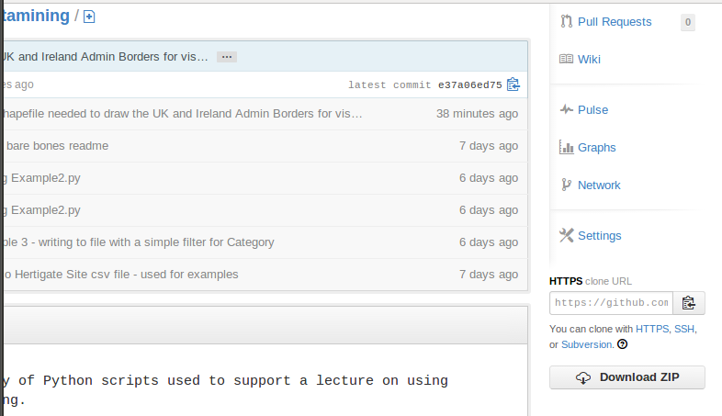
All of the source code is available - fully working from GitHUB
There are a few ways to download this entire repository but….
The easiest way might be to just download as ZIP file and then extract (it will give you the entire file structure etc of the GitHub repository for the lecture)

Slide 8
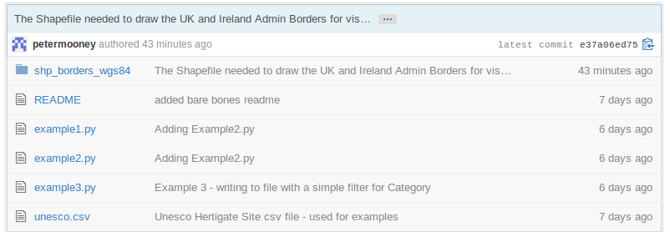
https://github.com/petermooney/datamining
If you want to follow the source code explanations in the lecture - you can just click on the appropriate file name in the GitHub repository for this lecture

Slide 9
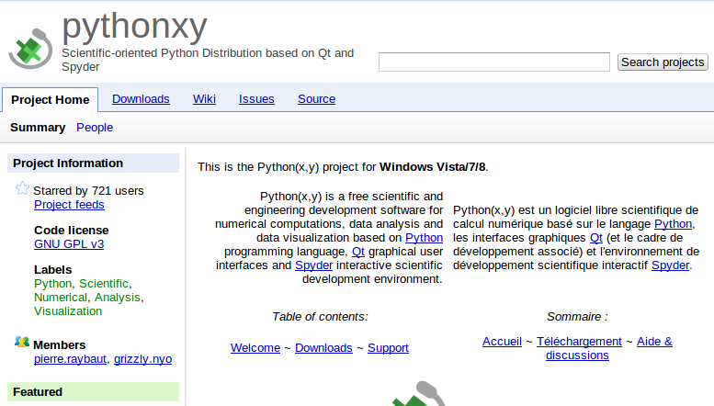
PythonXY is recommended for those new to working with Python

Slide 10
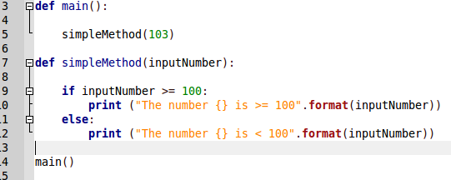
Running a piece of python code
Python code is best placed in text files often called ‘scripts’. They have .py as the file extension.
In Python code the amount of space (tabs, etc) used is very important - we are not covering this now but this determines ‘the flow’ of execution of the code.
For this reason it is best to use a text editor such as ‘Geany’ for Python
A file called “myFirstScript.py”
Can you guess what this Python program does?

Slide 11
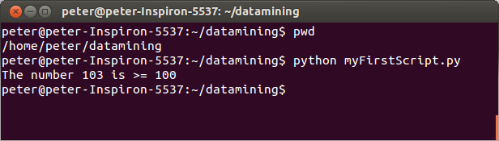
Now we have to run the code to see the output from the script
The best way to run your code is using a ‘command prompt’ or ‘terminal window’. You must go to the directory/folder where you have your script.
When you are there - on the command prompt - you must type the command python myFirstScript.py
http://www.wikihow.com/Change-Directories-in-Command-Prompt
Right clicking on the file will often work too.. provided the command window stays open..
This is how we will be running all of the code which you see in the GitHUB repository

Slide 12
We are not trying to learn Python tonight in the lecture!
Python is being used as a means of showing how data mining tasks are performed.
The Python source code is provided so that you can try the examples offline yourself (but this is purely optional)
You don’t need to understand the programming code - but try to understand the concepts/processes involved in the data mining tasks

Slide 13
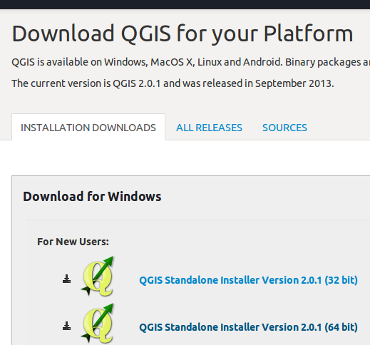
QGIS - A free GIS software tool is used to help with visualisations
http://www.qgis.org/en/site/forusers/download.html

Slide 14
Using Python for Data Mining and Visualisation

Slide 15
One of the crucial first steps in data mining is “know your dataset”
You must understand:
How the data is structured
What data types are used
If there is missing data values
What the limits of observations are
Essentially - you need to know the characteristics of the dataset/database you are mining - including it’s idiosyncrasies (datasets are not always as they appear!)

Slide 16
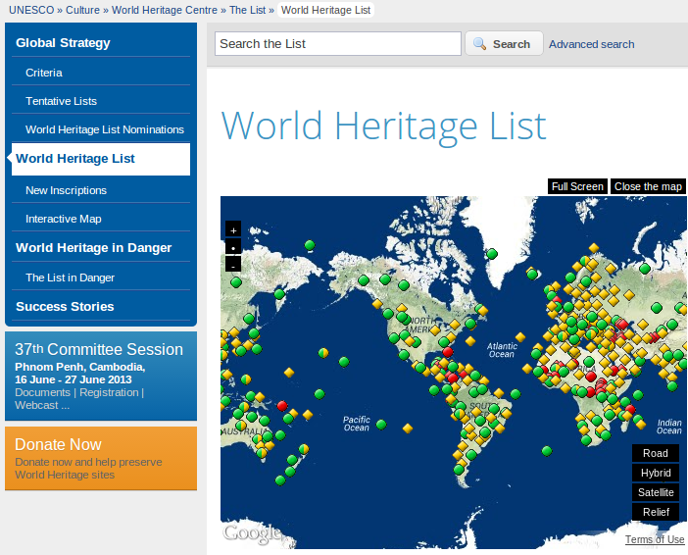
http://whc.unesco.org/en/list/

Slide 17
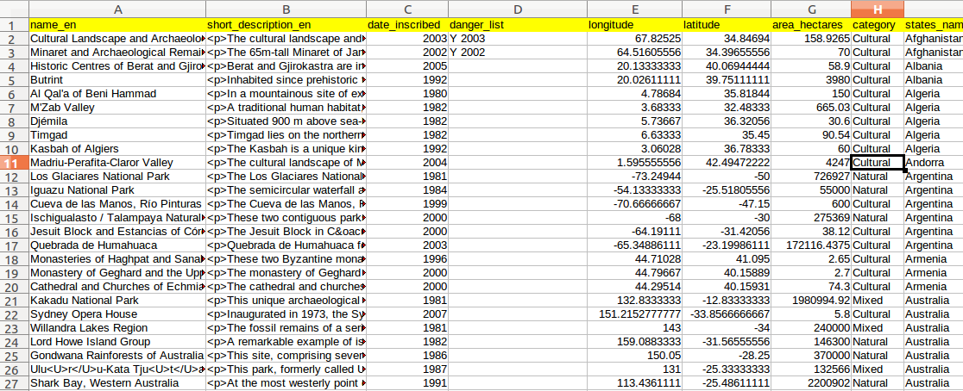
The UNESCO Hertigage CSV File

Slide 18
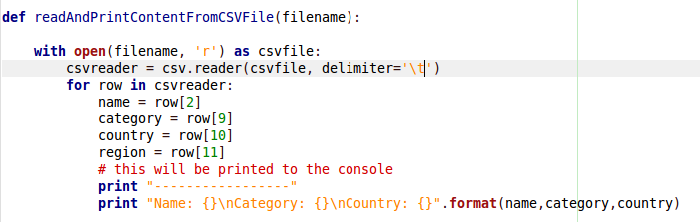
Example 1: Printing the UNESCO dataset with Python
Don’t worry about the python code - can you figure out what this code is going to do?
Python will read through the CSV file and print out the values from selected columns

Slide 19
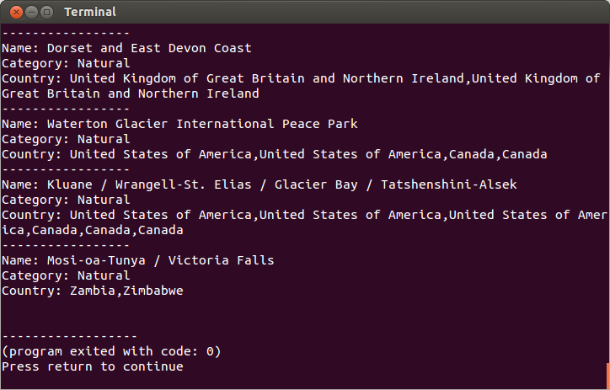
Example 1: Output to terminal window

Slide 20
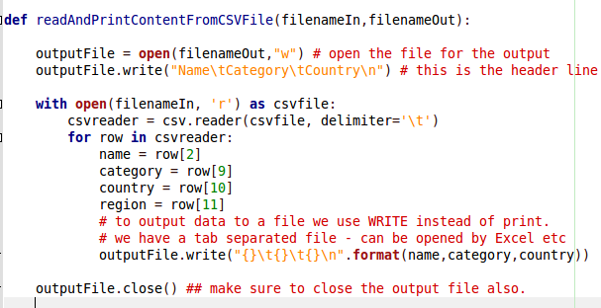
Example 2: Reprinting the data to another file output
This is useful when we have a big dataset but we want to automatically make it smaller or more manageable.
Here we just take 4 of the total columns and make a CSV file with the output

Slide 21
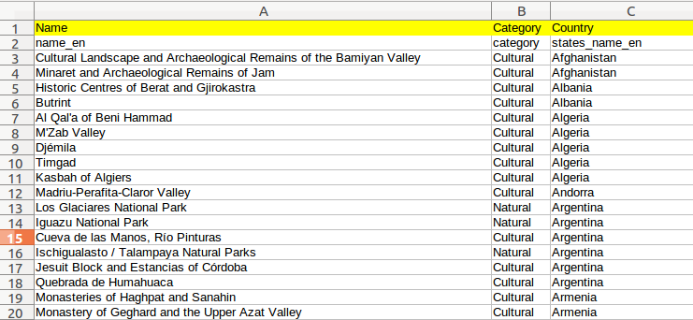
Example 2: The output CSV file with just 3 columns of data

Slide 22
Example 3: Subsetting the data
Often we are only interested in a smaller subset of the actual dataset we have
Extracting a subset of the data can make the processing and subsequent analysis much more manageable
Let’s extract subsets of the UNESCO dataset based only on the ‘category’ column

Slide 23
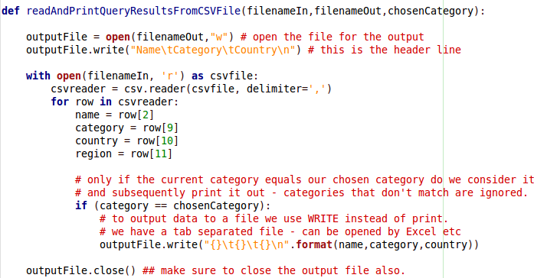
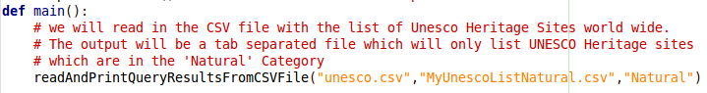
Example 3: Making the subset
chosenCategory can be “Natural”, “Cultural” or “Mixed”

Slide 24
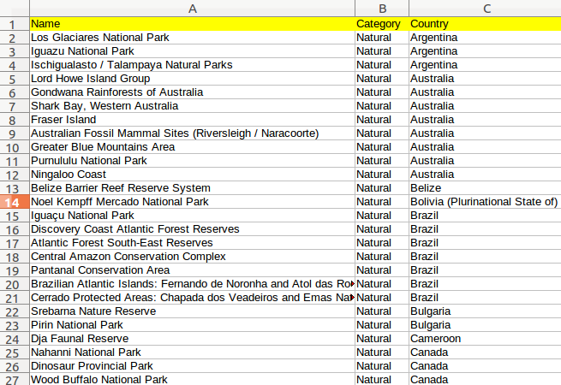
Example 3: The output
The new output CSV file contains only the UNESCO heritage sites with CATEGORY = NATURAL

Slide 25
Example 4: Counting things
Suppose in the UNESCO dataset we want to count how many heritage sites are on each continent.
This is a popular type of query
We are going to use Python and use a “dictionary” (a special data structure) to hold the number of heritage sites in each continent

Slide 26
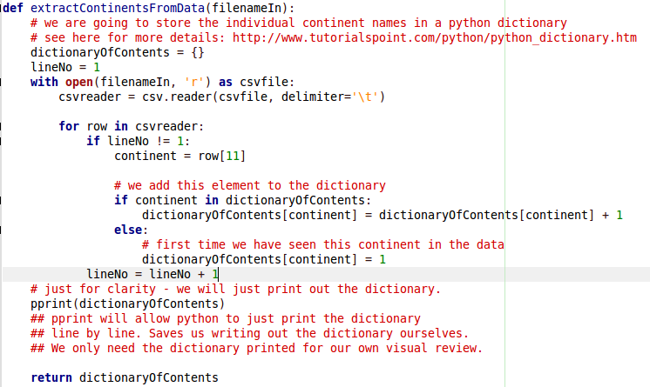
Example 4: Counting Continents
Let’s not worry too much about the python code - rather see if you can understand how the dictionary is being used

Slide 27
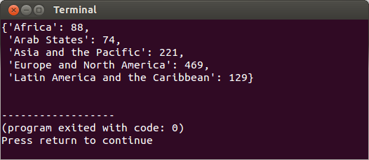
Example 4: Counting Continents Output
The output is very simple - the pprint() statement in the Python code has printed it in this way.
This is a good piece of summary information - but it would be nice to present it in a more interesting and appealing way.

Slide 28
Plotting in Python

Slide 29
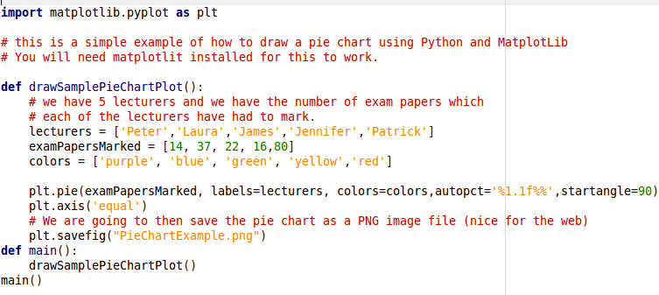
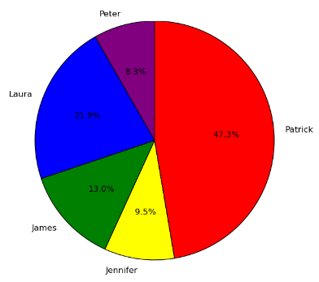
plotExample1.py - A pie chart

Slide 30
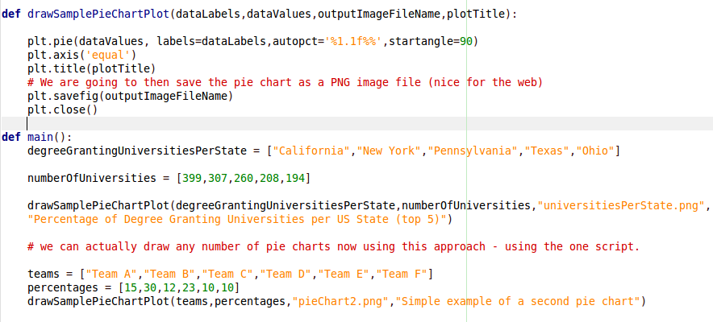
plotExample2.py - more pie charts

Slide 31
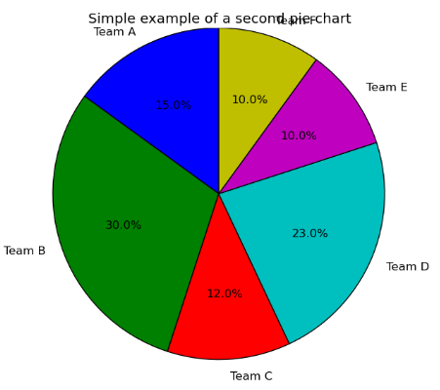
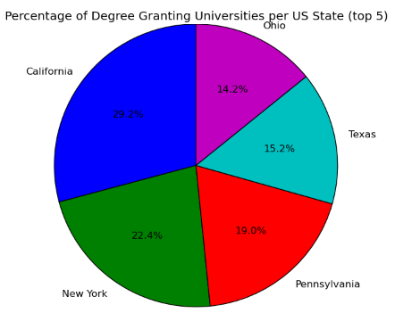
plotExample2.py - more pie charts

Slide 32
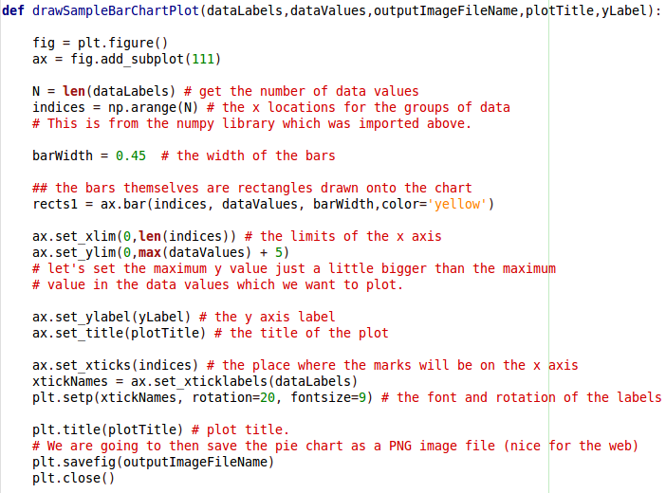
Plotting
a simple
Bar Chart

Slide 33
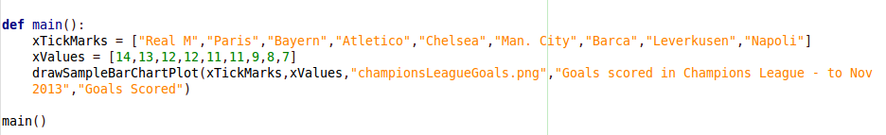
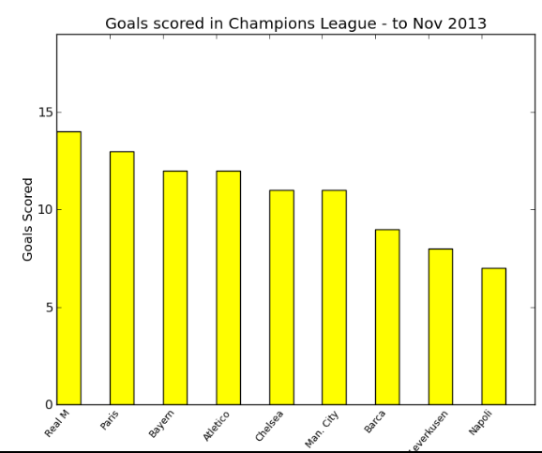
plotExampleBarChart.py
It should be reasonably easy to see how the data is transformed.
The great thing is that the method called “drawSampleBarChartPlot” can be re-used - we can use it for lots of different datasets. This is very useful indeed.

Slide 34
Example 5: Let’s draw some charts
We are going to use the code from Example 4 - we are going to make a bar chart of the continents.
This Python code is a little bit more complicated - again let’s not concern ourselves too much with the precise details of the code.

Slide 35
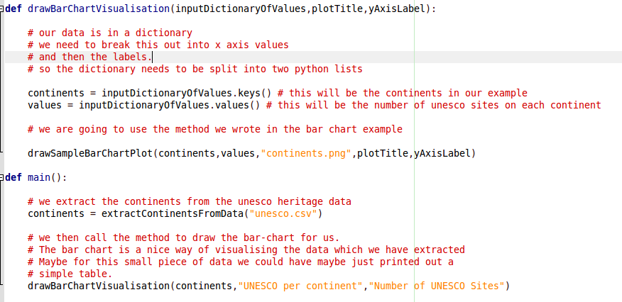
Example 5:
Remember this from Example 4

Slide 36
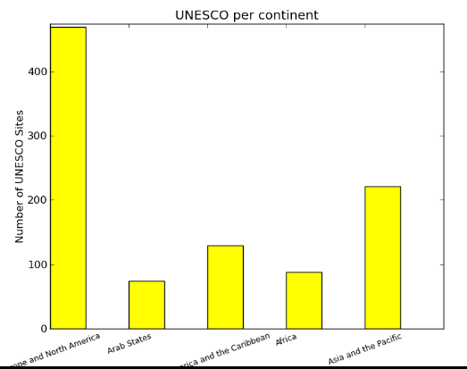
Example 5: Plot Output
From Example 4

Slide 37
Working with data direct from the CSV file is not very flexible
There is a lot of work associated with just extracting the data from the input data file
This is the data mining before we do any visualisation or interpretation of results.
We want to separate the processes of data extraction, analysis, and visualisation etc

Slide 38
Using a database

Slide 39
There are literally hundreds of options for databases - all with different pros and cons
Commercial Databases
Free and Open Source Databases
Industry - mission critical databases
Multi-transactional - high traffic databases
Simple file-structure databases
etc etc...

Slide 40
In theory we should use a proper spatial database for the next examples
Something like PostgreSQL PostGIS or Oracle Spatial Database
However - we are going to use SQLite
Essentially we are handling Spatial Data but having a fully featured spatial DBMS will just complicate things for tonight’s lecture

Slide 41
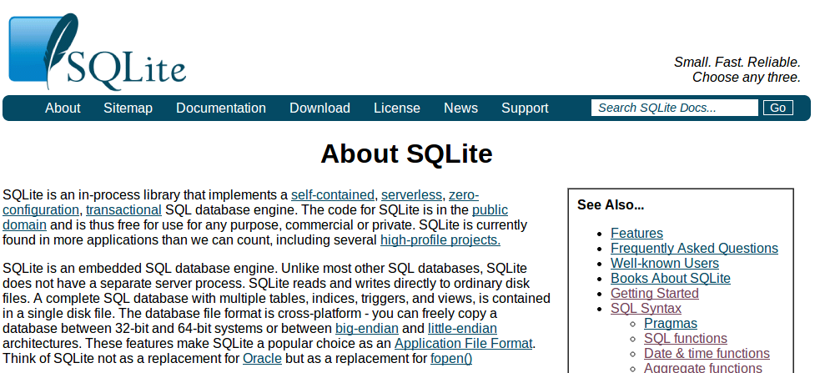
SQLite

Slide 42
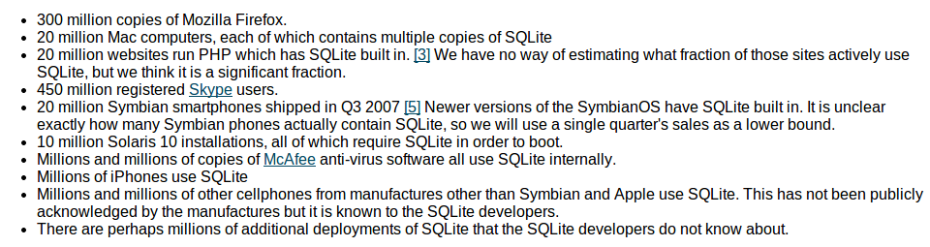
SQLite - “The most widely deployed database in the world”
http://www.sqlite.org/mostdeployed.html

Slide 43
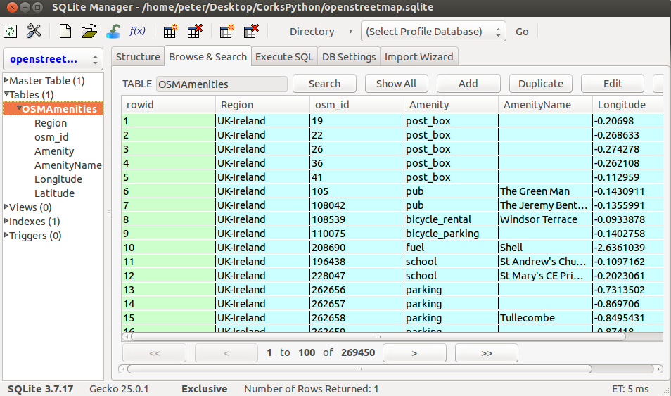

Slide 44
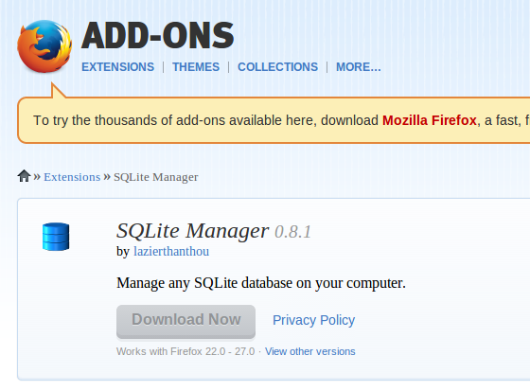
Firefox has a nice SQLite Manager Tool - cross platform
https://addons.mozilla.org/en-US/firefox/addon/sqlite-manager/

Slide 45
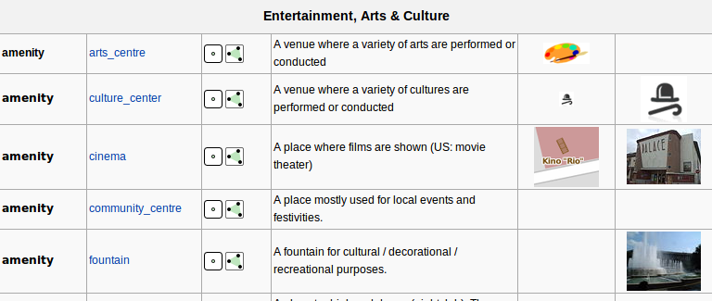
The OpenStreetMap Amenity
MapFeatures Wiki Page
http://wiki.openstreetmap.org/wiki/Key:amenity

Slide 46
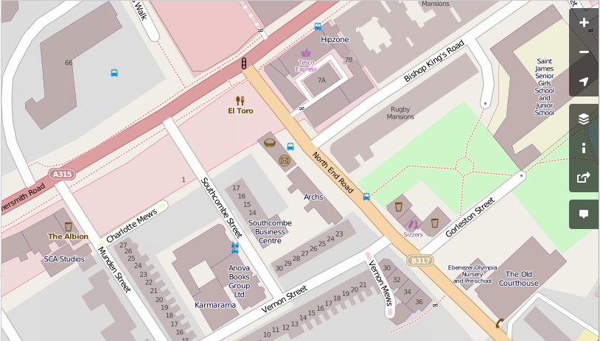
Example of an OpenStreetMap Map

Slide 47
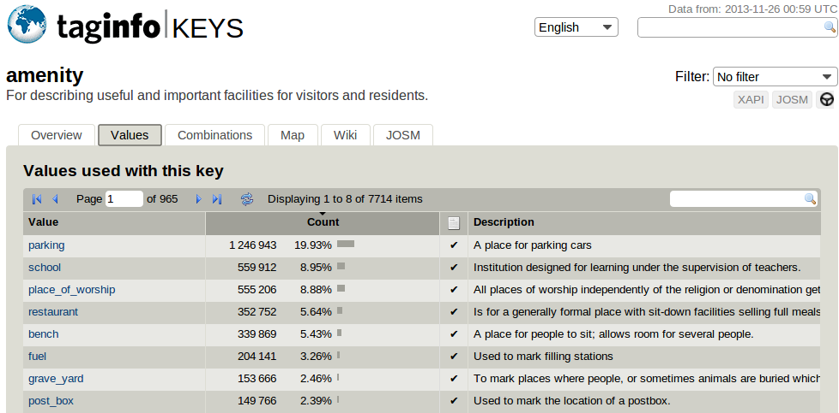
OpenStreetMap (amenity)

Slide 48
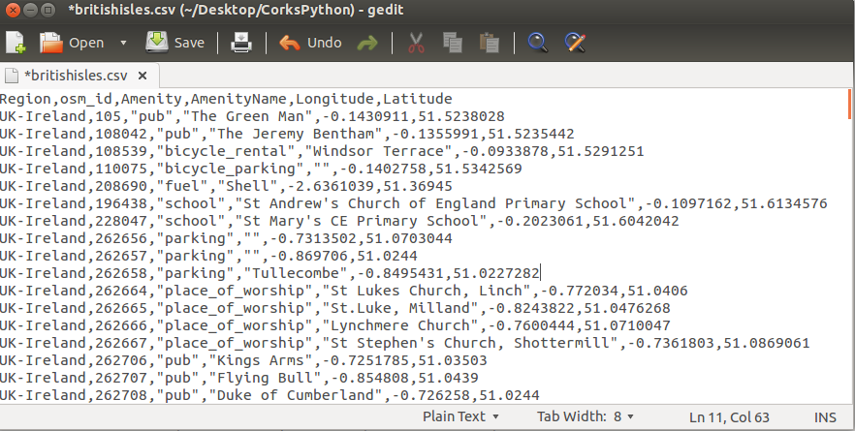
Our OpenStreetMap ‘amenity’ data in CSV file format

Slide 49
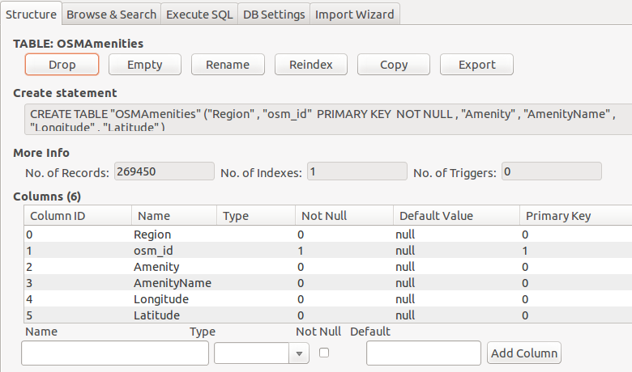
SQLite table structure of our CSV

Slide 50
We are going to use a modified version of this CSV file
We are going to convert the (Latitude, Longitude) to Universal Transverse Mercator (UTM)
(Latitude, Longitude) - WGS84 is a ‘degree’ based coordinate system - we measure things in distance measures (meters, miles, etc)

Slide 51
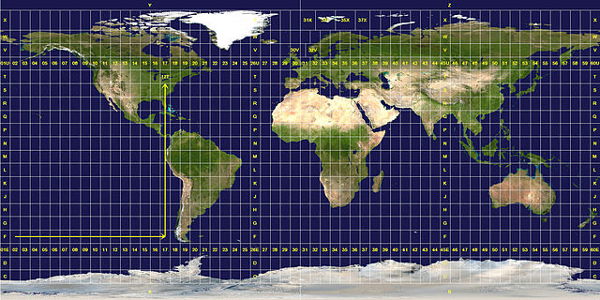
Universal Transverse Mercator (UTM)
http://upload.wikimedia.org/wikipedia/commons/thumb/e/ed/Utm-zones.jpg/640px-Utm-zones.jpg

Slide 52
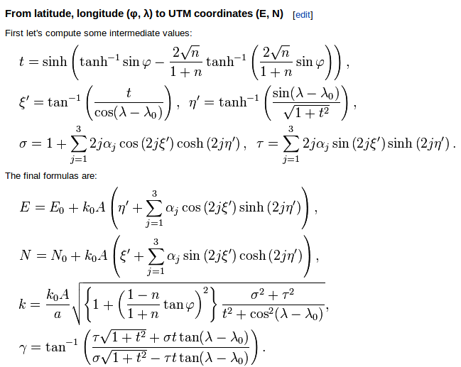
UTM allows us to do all sorts of useful computations
Distance queries: how far is x from y?
Area/size queries? Spatial queries - how many x are inside y?
Scary stuff…
http://en.wikipedia.org/wiki/Universal_Transverse_Mercator_coordinate_system

Slide 53
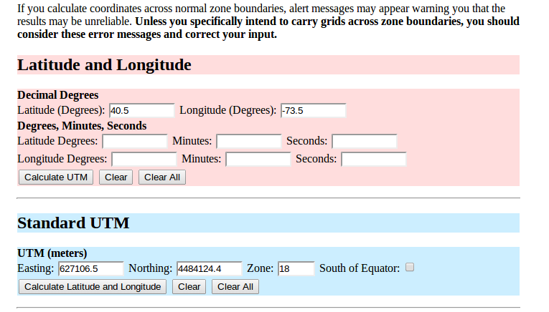
There are lots of converters for UTM
http://www.uwgb.edu/dutchs/usefuldata/ConvertUTMNoOZ.HTM

Slide 54
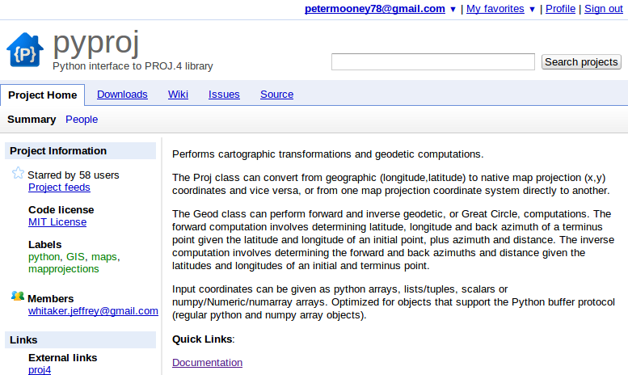
There are several Python options...

Slide 55
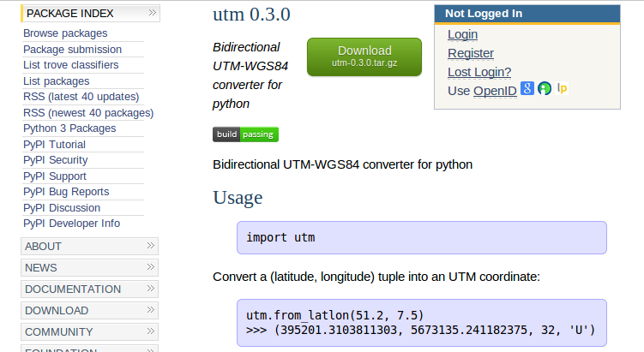
A very simple and easy to use Python library called UTM
https://pypi.python.org/pypi/utm

Slide 56
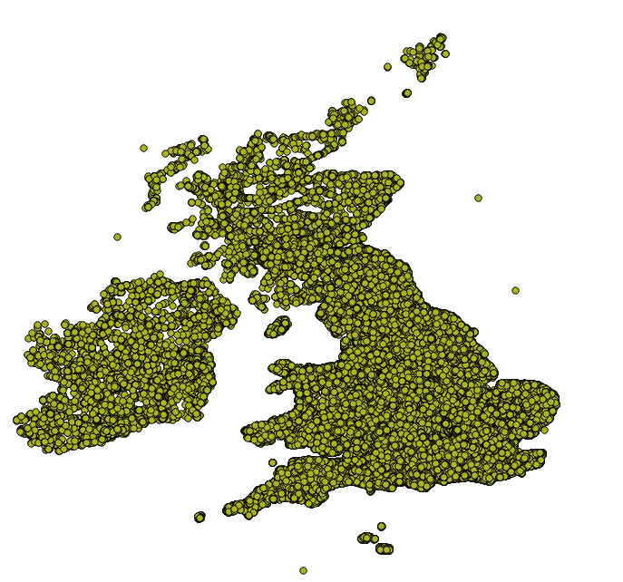
Our dataset for the remainder of the lecture
The CSV file is in the GitHub Repository for the lecture
OpenStreetMap
All AMENITIES from the British Isles
269,467 data points in total
Processed from data found here on GeoFabrik http://download.geofabrik.de/europe.html

Slide 57
Let’s get to know our dataset
One table - arranged in columns
The ‘AmenityName’ column can have empty or null values
The ‘Amenity’ column should never be empty
The Latitude, Longitude, UTMX, UTMY columns should be doubles/floats - never empty

Slide 58
We can actually perform our queries in two different ways
Using FireFox and the SQLite Manager
Advantages: Visual, easy to use, user friendly
Disadvantages: limited in how you can link into further processing
Using Python to access SQLite
Advantages: Easy to program, links in with visualisation and further analysis, more portable
Disadvantages: little bit of learning required

Slide 59
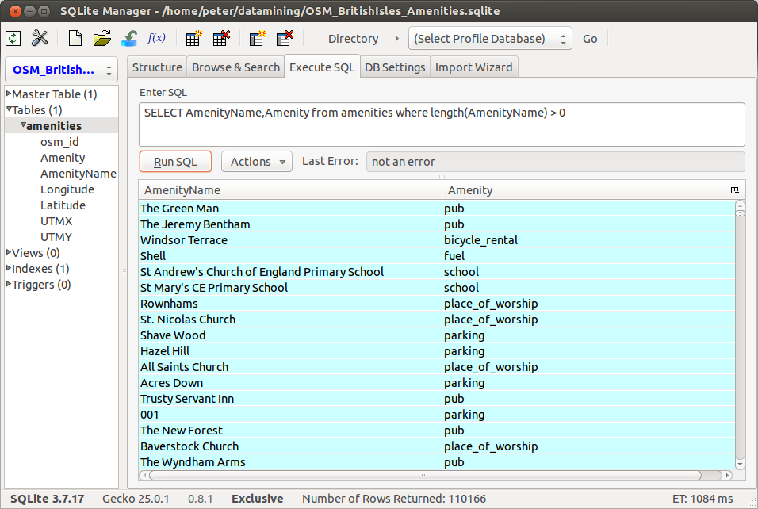

Slide 60
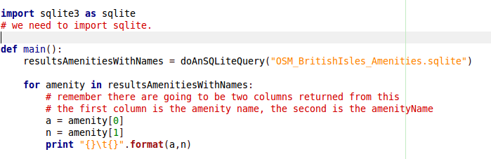
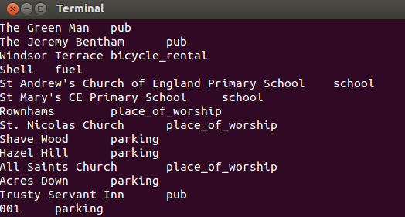
Using Python to access SQLite
SQLite_example1.py

Slide 61
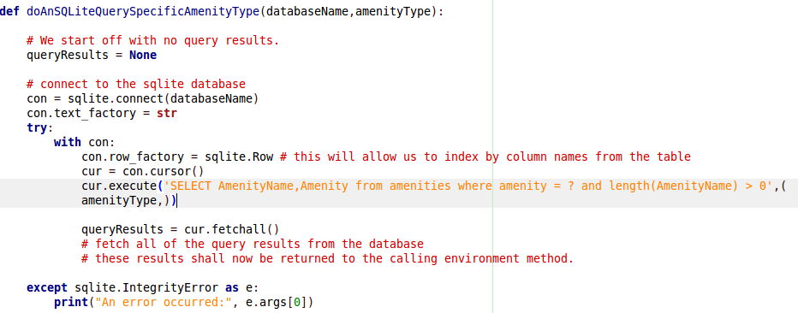
Example 2: Find all pubs (amenity = pub) in British Isles dataset
SELECT AmenityName,Amenity from amenities where amenity = “pub” and length(AmenityName) > 0
SQLite_example2.py

Slide 62
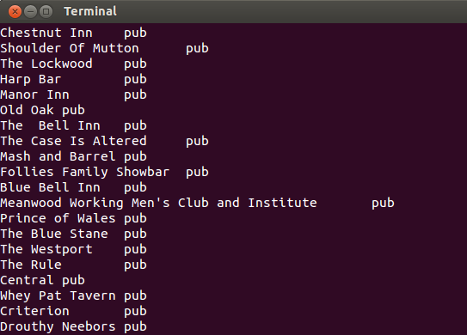
Example 2: Output

Slide 63
Example 2: Find all pubs (amenity = pub) in British Isles dataset
The problem here is that we are just given back a list of pubs
We can easily extract their coordinates
We need to MAP our output.
So let’s put the query results into a file and then visualise the output in a GIS system

Slide 64
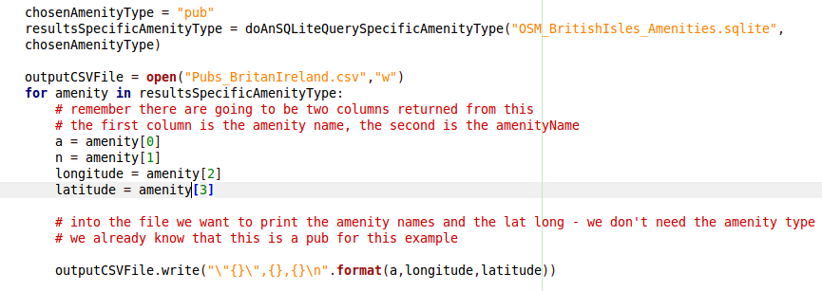
Example 3: Create a CSV file with coordinates of all pubs in UK + Ireland
SQLite_example3.py
SELECT AmenityName,Amenity,Longitude,Latitude from amenities where amenity = “pub” and length(AmenityName) > 0

Slide 65

Example 3: We obtain a nicely formatted CSV file with coordinates
Let’s visualise this
Let’s use QGIS (a few GIS software tool)
QGIS can read in CSV files like this and map them.

Slide 66

Load a delimited text file
(You might need to enable this plugin from the Plugins menu on the menu bar)

Slide 67

OK - We can see the query is working - but no outlines of the countries?

Slide 68
Let’s add another geographic layer
In the GitHUB repo you will find a folder with a shapefile in it (.shp)
Folder name “shp_borders_wgs84”
You will need to download this entire folder (this should have happened anyway)
Our data for today is downloaded from:
http://www.naturalearthdata.com/downloads/10m-physical-vectors/

Slide 69

This screenshot shows you how to add this SHAPEFILE vector layer to the QGIS visualisation. It’s really just a matter of browsing for the correct SHP file

Slide 70

wow! Lots and lots of pubs
This is a nice display - but what does it tell us?
Nothing much - it tells us there are pubs everywhere.
Let’s refine our query a little

Slide 71
Example 4 - Let’s be specific about the name of the pub we want to find
Let’s look for pubs (amenity = pub) where the pub name (AmenityName) matches some criteria we provide.
For example: all pubs whose name includes the name ‘Murphy’ or pubs whose name includes the word ‘Gastro’.

Slide 72

Example 4 - Find and visualise all pubs with ‘Queen’ in the name
SELECT AmenityName,Amenity,Longitude,Latitude from amenities where amenity = “pub” and instr(AmenityName,”Queen”) and length(AmenityName) > 0
SQLite_example4.py

Slide 73

Example 4 - We visualise the results output in the CSV file
As “Queen” is a very popular name in pubs in the UK but not in Ireland - our visualisation verifies that the results of our query are most likely correct!

Slide 74
It’s possible to do more sophisticated string matching in the database
Suppose we want to find pubs which only have the word ‘TAVERN’ at the end of their name. It can only appear at the end.
SQL has the LIKE Operator for that.
So we say amenityName LIKE “%Tavern” - the % means - you can have any characters before it - but string must end with tavern

Slide 75
Other simple examples
amenityName like “The%man” will match names like ‘The Irishman’ or ‘The Forgeman’ but it would not match “Workman’s” - because the ‘s comes after the characters ‘man’
amenityName like “%and%” will have lots of matches - such as “Needle and anchor”, “Bill and Ted”, “Landsdowne inn”. It will also match ‘The Golden Island’ because the second % allows zero or more characters

Slide 76

Example 4a: pubs with the word “Tavern” in their name
SELECT AmenityName,Amenity,Longitude,Latitude from amenities where amenity = “pub” and AmenityName LIKE "%Tavern%" and length(AmenityName) > 0
SQLite_example4a.py
NOTICE: It is a little more complicated to express the LIKE operator in the Python script - this is the standard way above (let’s not worry too much about it for now)

Slide 77

Example 4a: Query Results
There are over 600 results - but looking at the first few - it looks like we have got the correct results .
Now let’s see how these are spatially distributed

Slide 78

Example 4a:

Slide 79

Example 5: We can extract information on other amenities
SELECT AmenityName,Longitude,Latitude from amenities where amenity = “restaurant” and AmenityName LIKE "%pizza%" and length(AmenityName) > 0
SQLite_example5.py
Our Python Code changes very little.

Slide 80

Example 5: We can extract information on other amenities
amenity=restaurant where the word Pizza is in the amenity name…
So this query is useful - but very likely misses restaurants that serve pizza

Slide 81
Example 6 - Let’s go back to creating charts again with Python
We have seen that we can plot outputs from queries on a map using Python as the query and analysis software between DB and GIS tools
Let’s use Python to extract some data from the DB and draw it in a chart or graph

Slide 82

Example 6 - Finding the most popular amenity in UK and Ireland in OSM
SELECT Amenity, count(*) as NumAmenity from amenities
group by amenity
order by NumAmenity desc
LIMIT 10
This query finds the 10 most frequently occurring amenity types in the UK and Ireland - we need to group all “amenity” values together so that we can count them - then order them in descending order and return the first 10

Slide 83
Example 6 - Finding the most popular amenity in UK and Ireland in OSM
We are going to see some nice reuse of software code here.
Remember in ‘plotExampleBarChart.py’ we had a method which would draw a bar chart for us if we provided the data. It was called “drawSampleBarChartPlot”
We are going to use that in Example 6

Slide 84

Example 6: drawing the plot
SQLite_example6.py
We are going to use the results of our query (top 10 amenities) to make a bar chart

Slide 85

Example 6 - The output
This is a much nicer way to present this data than just on the terminal or just as a CSV file

Slide 86

Geographic Bounding Boxes
Top Latitude
Left Longitude
Right Longitude
Bottom latitude

Slide 87

Finding
(Lat, Long)
of a place

Slide 88

In the next example lets find all amenities in central London
This is our bounding rectangle

Slide 89
sqlite_example7 - extract all amenities in Central London
SELECT * FROM amenities where latitude >= 51.4838 and latitude <= 51.5172 and longitude >= -0.1461 and longitude <= -0.0808
This is using our geographic bounding box from the previous slide
Latitude
51.5172
SQLite_example7.py
-0.1461
-0.0808
Longitude
51.4838

Slide 90



Slide 91


Central
London Example

Slide 92
The Bounding Box example can be expanded to be more informative
Suppose we want to cycle in London - we want to know where there is bike rental (amenity=bicycle_rental)
Let’s expand our BB to the M25
Our bounding box will have coordinates
51.7279
-0.5713
0.3227
51.2611

Slide 93
sqlite_example8
SELECT * FROM amenities where Amenity = "bicycle_rental" and latitude >= 51.2611 and latitude <= 51.7279 and longitude <= -0.3227 and longitude >= -0.5713
Very little has changed in this example - we just need to be able to specify what the amenity type is …
Everything from the example sqlite_example7 is the same.
This is really useful.

Slide 94

sqlite_example8 - results

Slide 95
What about finding an ATM in Dublin?
SELECT * FROM amenities where Amenity = "atm" and latitude >= 53.2402 and latitude <= 53.4144 and longitude <=-6.0315 and longitude >= -6.3995
We just change the bounding box coordinates and the amenity type!
We have included all of Dublin inside the M50 (roughly)
sqlite_example8_dublin.py

Slide 96


sqlite_example8 - Dublin ATM results
There are some potential limitations to these results. Discuss?

Slide 97
Issues with Bounding Boxes
They are very simple - but are a very crude way of doing a spatial query
Not many things in geographic space fit neatly inside a rectangle
For more advanced types of queries we would use irregular polygons (such as administrative areas, county boundaries) rather than Bounding Boxes

Slide 98

Finding distances between objects
Mary
Joe
Me
In geographic space - we have our coordinates in geographic coordinates.
In our amenities database we have coordinates in UTM - Which makes it very useful for distance-based computation. UTM is measured in meters
UTM of the Four Courts in Dublin is approximately
(681411.436,5914305.64) (x,y) or (p1,p2) above
Jane
Rory
Who am I nearest to?
What if there were thousands of these?

Slide 99
Writing Euclidean Distance in sqlite
Unfortunately - sqlite has no support for sqrt or power functions. So we have to be a little bit flexible with how we specify the Euclidean distance formula.
We will just specify it in long form and our distance buffer will be the square of what we want instead.

Slide 100
Euclidean Distance Example
d = (p1 -q1)(p1 - q1) + (p2 - q2)(p2 - q2)
d = (5 - 1)(5 - 1) + (6 - 3)(6 -3)
d = (4)(4) + (3)(3)
d = (16) + (9)
d = 25
So all we need to do is take the square root of this to give us the actual distance
* (5,6)
* (1,3)
The distance is 5 units.
So the square of this is 25

Slide 101
sqlite_example9 - Euclidean Distance
Suppose we have a point (lat, long) and we want to find how many amenities are within 5KM of your current position.
Every smartphone uses this functionality!
We are essentially then at the center of a circle with radius of 5KM.
Remember - it’s ‘as the crow-flies distance’

Slide 102
sqlite_example9 - Euclidean Distance
We are standing on O’Connell Bridge Dublin (53.347257,-6.259086) and we want to find out what amenities are within 2KM (longest walk) from where we are standing!
We would like a map - and when you click you can see amenity type and amenity name

Slide 103

sqlite_example9 - Euclidean Distance
SELECT * FROM amenities where ( (681411.436 -UTMX)*(681411.436 -UTMX) + (5914305.6 - UTMY)* (5914305.6 - UTMY))/100000 <= 4

Slide 104

sqlite_example9 - Euclidean Distance
SELECT * FROM amenities where ( (681411.436 -UTMX)*(681411.436 -UTMX) + (5914305.6 - UTMY)* (5914305.6 - UTMY))/100000 <= 4
Notice how the Database Query is written - in a database system such as PostGIS we would not have to do this - but this is good practice to see how we specify something like this.

Slide 105
Dublin Roads Shapefile
I have used the Geofabrik OpenStreetMap download service to obtain a shapefile of all Roads, Railways, Rivers, etc in Ireland.
I have prepared the ‘Roads’ dataset for greater Dublin and it is available to download from Github

Slide 106


sqlite_example9 - All amenities within 2km buffer of O’Connell Bridge

Slide 107
sqlite_example10 - finding specific amenities within a distance buffer
Suppose we are at Heuston Station Dublin and we want to find a post office (amenity=post_office).
(53.34654046180465, -6.2923781893914565
Ideally we don’t want to walk too far - 1 mile maximum (so 1.6KM)
So our distance squared is 2.56

Slide 108

sqlite_example10 - finding specific amenities within a distance buffer
SELECT * FROM amenities where ( (680232.011 -UTMX)*(680232.011 -UTMX) + (5914239.030 - UTMY)* (5914239.030 - UTMY))/100000 <= 2.56 and amenity = “post_office”

Slide 109


Two post offices within 1.6KM buffer of Heuston station

Slide 110
Summary
We have just really scratched the surface - (Spatial) Data Mining is a very broad topic.
However the principle of: Load Data (into a database for example), Extract (using something like Python), Transform (if necessary), and Visualise is always the same

Slide 111
Learning Outcomes 1 + 2
Try to reuse code - Notice how all of our examples were small incremental extensions of the previous example
Separate out processes - Notice how we let QGIS do map visualisations - Python just prepared the spatial data after extraction from the database

Slide 112
Learning Outcomes 3 + 4
Understand your data - In all examples we had to make sure that we understand the structure of the dataset/database
Keep things simple - Break the problem down into manageable steps. For example the BarChart visualisation. This make it easier to build flexible reusable software solutions

Slide 113

Thanks for listening…
Hopefully this has been useful to you all this evening. Don’t worry about the coding - think more about the processes involved.
Am happy to take post-lecture questions at
peter.mooney@nuim.ie
http://www.flickr.com/photos/26432908@N00/11188666563/sizes/c/

